Slide 1
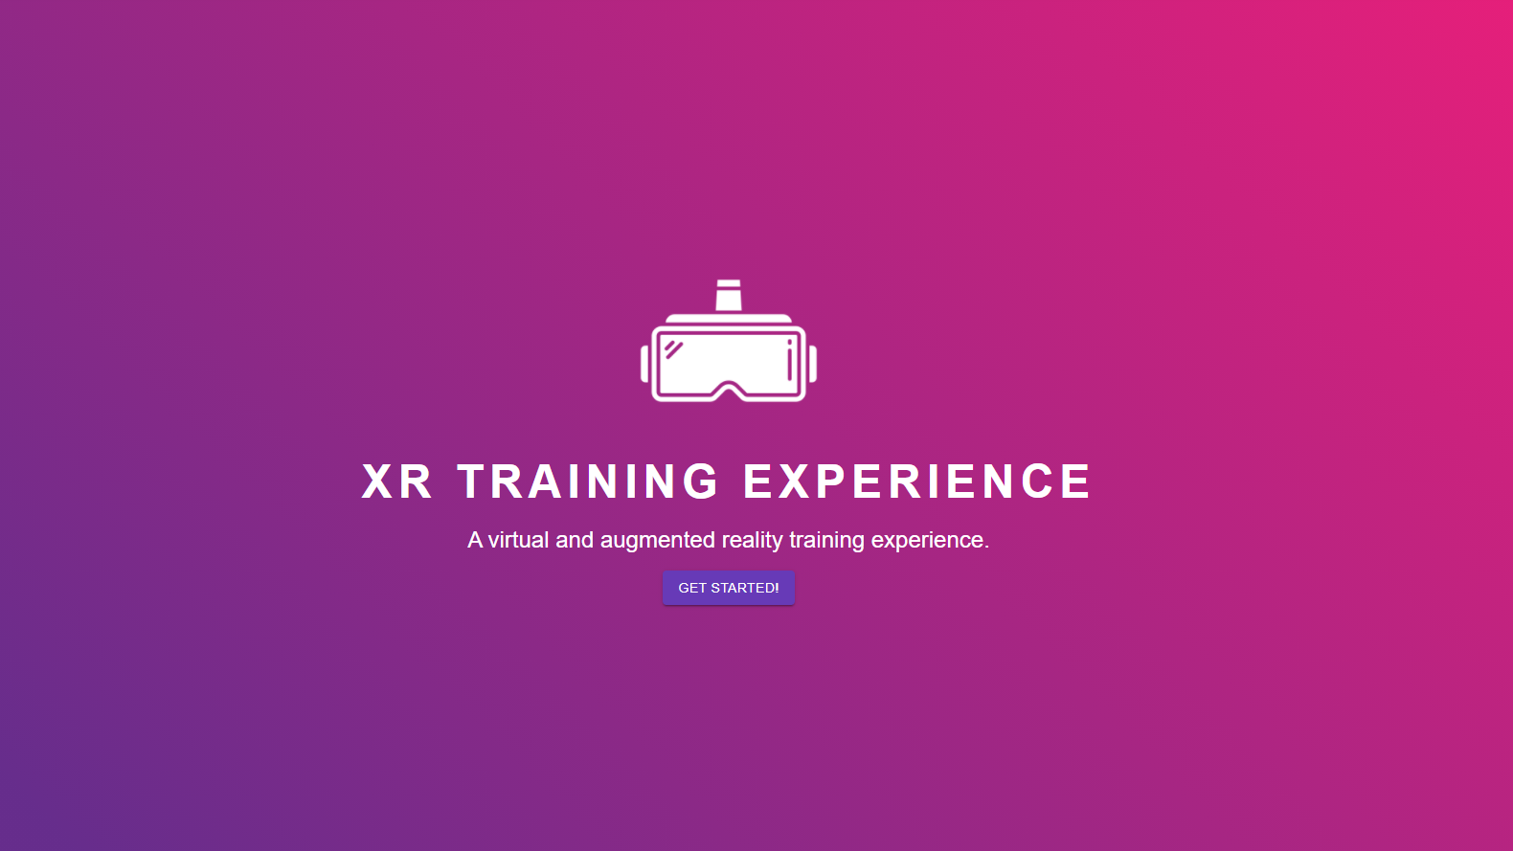

Slide 2
Problem Description
Many large organisations need to deliver training to their new employees which can be resource and time consuming. In the hospitality industry, employees usually waste many resources such as ingredients during the initial training process which can be lengthy itself. The waste of resources and lengthy training sessions translate to an inefficient use of an organisation's budget.

Slide 3
Background Research and Users’ Needs
XR technology has gained more popularity over the last few years in many industries
Restaurants and cafes need an efficient way to train new employees in making food and beverages without wasting resources in order to save time and money
Conducting training in person can often be quite costly and inefficient due to the resource waste and training supervision required.
Developing custom software for a company's unique training is costly

Slide 4
Comparisons or Differences
Another method involves the employee reading instructions/menus (as homework) on how to make burgers which is a good starting point but is not effective in fostering practice-based learning​
Another solution is e-learning and interacting with an instructor at certain points
These methods are good starting points but do not foster practice-based learning

Slide 5
Project Scope
Our Extended Reality (XR) Training System aims to deliver virtual food and beverage training for the hospitality industry. In the context of SES 3A, this will be focused on providing employees with training on making burgers in a virtual environment without wasting ingredients.

Slide 6
The key/Main Tech
We plan to use VR/AR technology which would allow restaurants and cafes to create custom training modules
HTC Virtual Reality System (headset and controllers) - allows employees to actually make burgers in a simulated virtual environment​ by interacting with the controllers and headset
Unity – the application which delivers the virtual training​
Web app – user interface that enables employees and staff to track training progress, complete and/or alter training modules and perform other administrative tasks

Slide 7
Overview of Software
Play video here

Slide 8
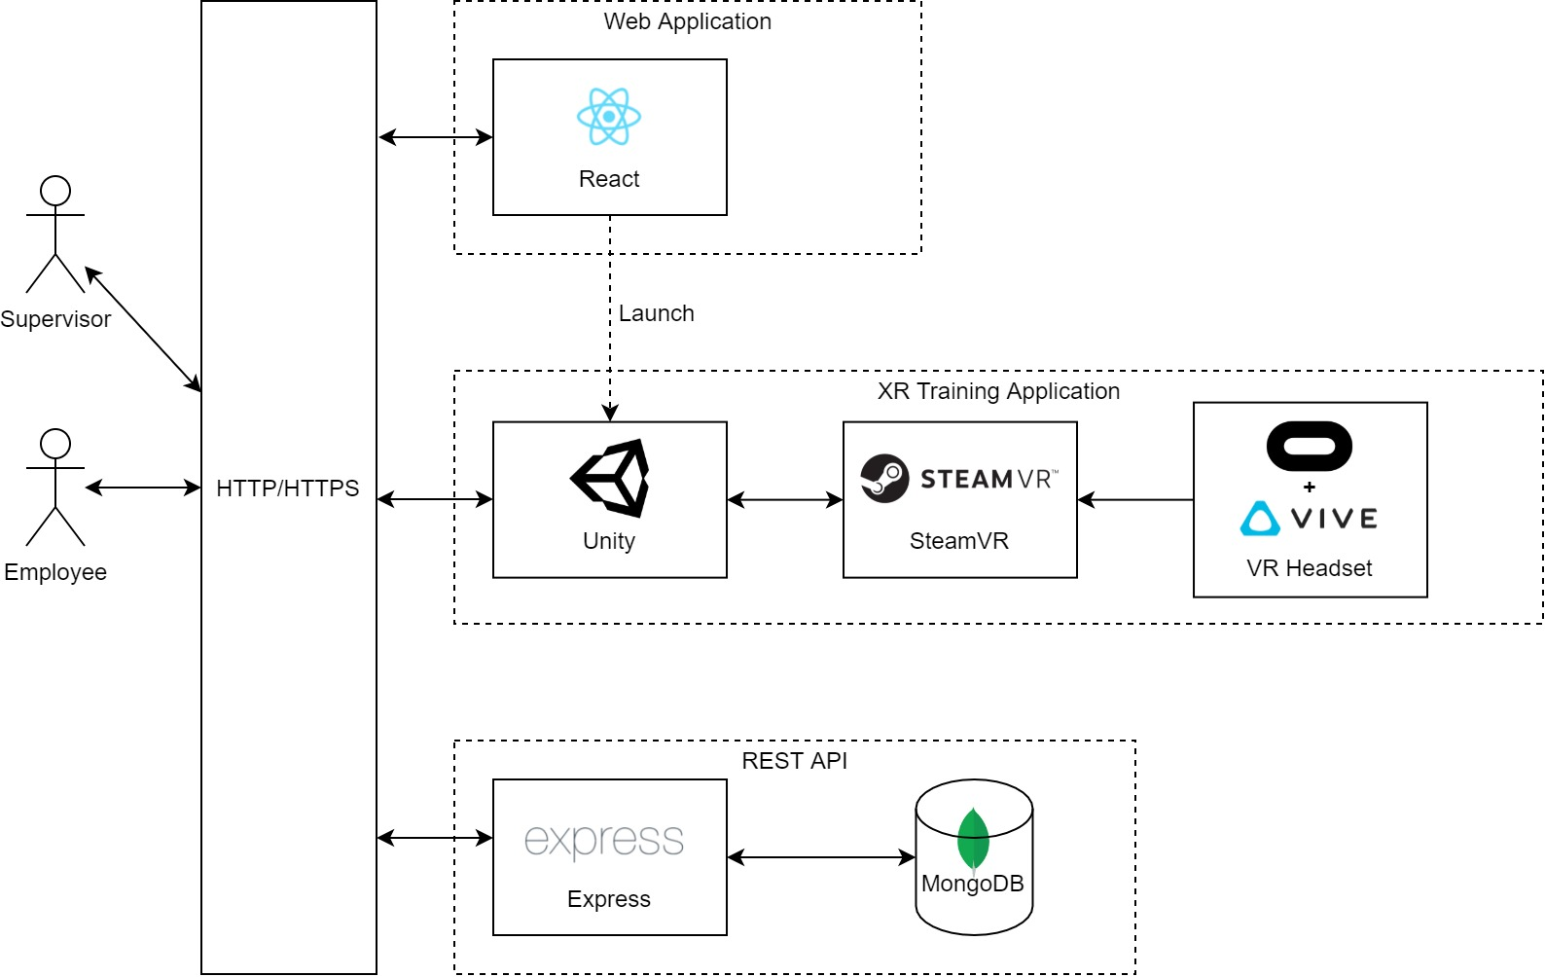
Overview of Solid Achievements

Slide 9
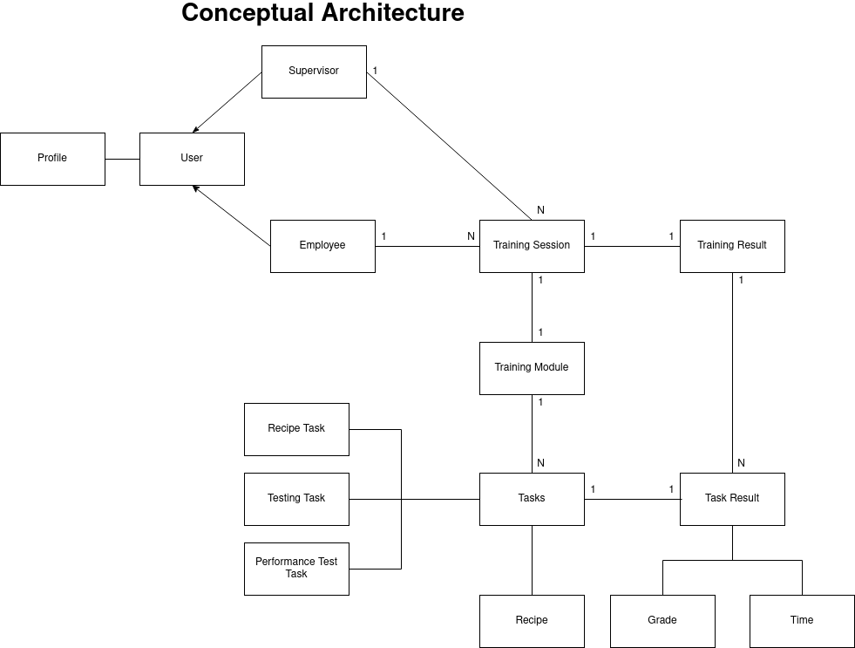

Slide 10
Introduce the key/new function(s)
Play video here

Slide 11
Next Step (business model / leading research / improvement)
Polish our XR Training System to make it a high quality professional product​
Approach burger joints such as McDonalds to pitch our product​
Develop the ability to create other forms of training (e.g. making drinks and desserts, fire safety training in a restaurant)

Slide 12
Teamwork/Management Review
Sprint 1​​​
Good | Average | Bad
Many innovative ideas from all members | Project ideas were too complex | Initial idea was not practical Not much development progress No VR Headset for testing Bottleneck in Unity development due to finalising framework.
Sprint 2​​
Good | Average | Bad
Unity development and backend development is progressing at a good pace | Much confusion about the structure of the training modules/courses/tasks Frontend development is behind schedule | Sprints were not planned well and many new tasks are being introduced and not being updated in the charter

Slide 13
Teamwork/Management Review
Sprint ​​​3
Good | Average | Bad
A lot of development progress is seen, and components are being integrated | Many issues with integration | Bugs in web application - frontend

Slide 14
Project Timeline / Achievement Review
|
|
|
Sprint 1: Weeks 4-6
Wireframes very nice
Frontend skeleton done
Backend skeleton DONE
XR development started
Sprint 2: Weeks 7-9
Core backend endpoints finished
Frontend backend integration
Separation of pages into employee and supervisor side
Core behaviours and scene of XR scenario completed
Sprint 3: Weeks 10-12
Can launch into XR scenario from webapp
XR scenario integration with backend
Employees can view task progress on webapp

Slide 15
Timeline Review
Overall achievements followed sprint plans
Some frontend tasks were pushed back a sprint
Some extra unplanned features were added in later
To prevent this in the future:
More strict deadlines
More concrete planning of product before development
Better planning of features

Slide 16
Thanks Q&A

